Slide 1
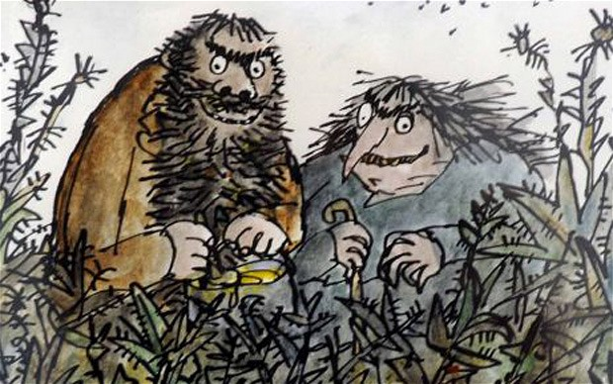
The Twits
2B’s Special Book Study

Slide 2
Activity Sessions
1 – Predict the story
2 – Retell the first chapter
3 – Draw Mr. Twit focusing on his beard
4 – Hot-seat the frog
5 – Create a new receipe
6 – Design a new nasty trick
7 – Write a play script for Chapter 7
8 – Walking stick tangram solving
9 – An NHS warning about The Shrinks
10 – Balloon Experiment
11 – Swag Bag Language 12 – Make a monkey in a cage
13 –Create a missing boys poster
14 – Collage the Roly-Poly Bird
15 – Research Muggle-Wump’s home country
16 – Write a new rhyming warning
17 – Debate whether glue was the right way to go…
18 – Guess the act
19 – Investigate language in Chapter 24
20 - Design a new front cover
21 – Change the characters
22 – Rewrite the story

Slide 3
Session 1 Predict what will happen in the story
Write a prediction of what you think will happen in the story. Only use the front cover to help you. Try and give reasons for your predictions, for example, ‘I predict that there will be two old people who enjoy gymnastics because on the front cover there is a man and a woman with some grey in their hair, doing handstands!
predict evidence why because characters settings events

Slide 4
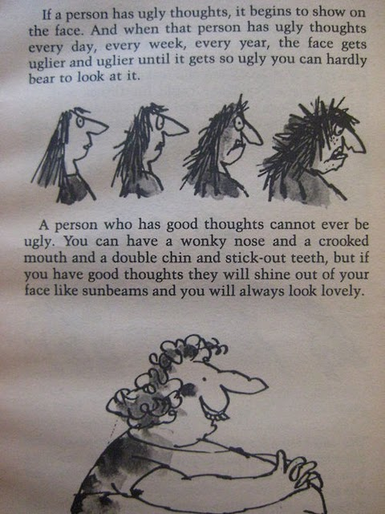
Session 2 Retell Chapter 1
In your own words rewrite the first chapter. Think about the characters, settings and events. How much of the story language from the chapter can you remember and use in your writing?
First Then Next
After Finally When

Slide 5
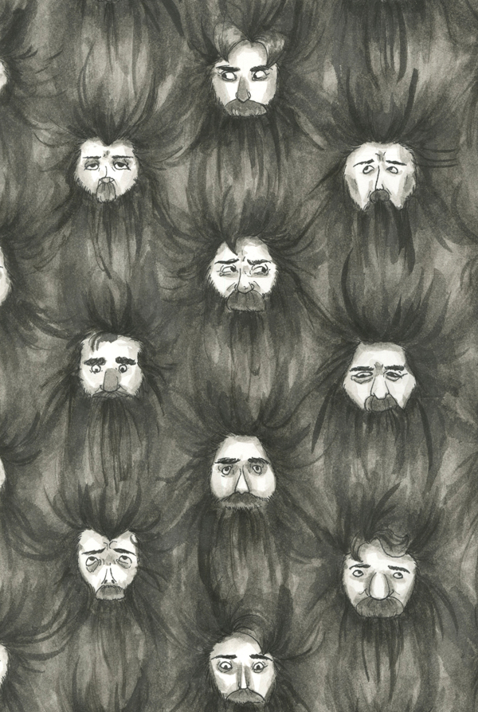
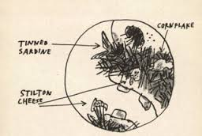
Session 3 Draw a picture of Mr. Twit (include the disgusting food stuck in his beard)
Sketch Mr. Twit with a focus on his disgusting beard. You may choose to use the style of the drawing below or create your own style. You are only allowed a piece of paper and drawing pencils.
pencil shade tone texture likeness dark light hard soft

Slide 6
Session 4 Hot-Seat the frog
The poor frog! Stuck in a bed with Mrs. Twit. How do you think he felt? First write a list of questions you’d like to ask the frog. Then hot-seat the character, tell everyone how you felt…
angry upset surprised anxious not amused
scared worried

Slide 7
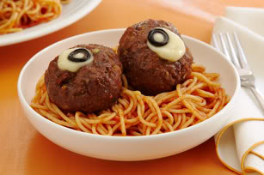
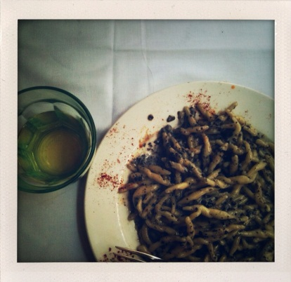
Session 5 Create a new receipe for Mr. Twit’s dinner
Eurgh! Mr. Twit did NOT like worm spaghetti. Can you write him a recipe for a tastier dish? Or if you don’t think he deserves it, perhaps you’ll choose to create him an even more revolting dish…
Make sure you write a list of ingredients and a method (instructions).

Slide 8
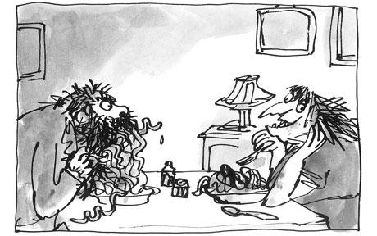
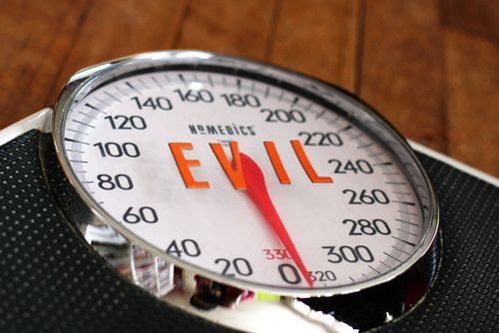
Session 6 Design your own nasty trick
Mr. and Mrs. Twit play some nasty tricks on each other. Are you more or less evil than then The Twits?
Find out by designing the worst trick you can think of…
nasty vicious evil premeditated callous
horrible mean

Slide 9
Session 7 Write a play script
Choose a chapter to turn into a play. Imagine that your play will be performed in front of a huge audience. How will you make sure it’s exciting to watch?
play script actor stage directions speech perform

Slide 10
Session 8 Walking stick tangram
Can you solve the walking stick tangram?
Cut out the pieces of the walking stick and then put it back together again. Make sure you think and talk about HOW you are solving the puzzle.
If you want more of a challenge, don’t look at the walking stick first!
tangram puzzle solve
strategy method
trial and error

Slide 11
Session 9 Health warning poster for The Shrinks
Here’s an informative poster about flu. Can you design an informative poster about The Shrinks?
health warning poster informative layout heading image facts

Slide 12
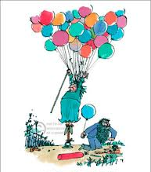
Session 10 Balloon Experiment
What do you think will happen if you put a deflated balloon with baking soda over a bottle of white vinegar?
Plan, predict, carry-out and write your findings!
experiment baking soda white vinegar plan predict findings record observe conclude

Slide 13
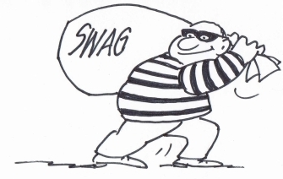
Session 11 Swag Bag Language
Get your swag bag ready! In groups read parts of the book and steal words that you think have an effect on the reader. Quickly put them in the swag bag.
The group with the most interesting words will win!
language audience effect
adjective adverb noun
verb because simile

Slide 14
Session 12 Make a monkey in a cage
Draw and cut a circle from thick white card, with a diameter of about 15cm. On one side draw a monkey and a cage on the other side. With a hole punch, punch two holes in the circle wither side of the monkey’s arms. Make sure the monkey is upside down, just like poor Muggle-Wump!
cardboard string hole punch
twist spin monkey cage
twirl design

Slide 15
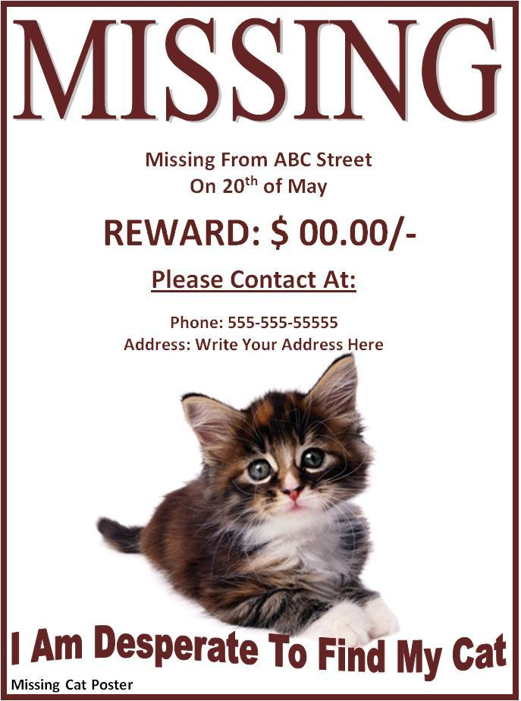
Session 13 Create a missing boys poster
The boys parents are worried Mr. Twit has them up and tree and their mums and dads don’t know where they are. They have spoken to the police and decided to put missing posters around the town. Can you design an eye-catching poster to help find the boys?
heading reward eye-catching informative contact information

Slide 16
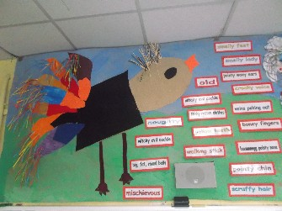
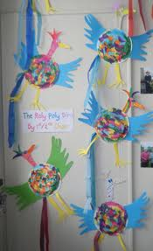
Session 14 Collage the Roly-Poly Bird
Collect lots of different types of materials; sweet wrappers, tin foil, feathers, shells, newspaper, magazines, bottle tops…
Use a range of materials to collage the Roly-Poly bird.
collage materials glue stick layer rip

Slide 17
Session 15 Research Muggle-Wump’s home country
What do you know about where Muggle-Wump comes from? Can you find reference in the book to which country the monkeys originate from?
Use books and the internet to explore facts about the country.
geography population land use traditions culture distance size

Slide 18
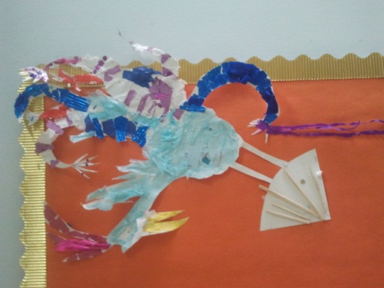
Session 16 Write a new rhyming warning
The Roly-Poly word is tired of singing the same old rhyme. Can you help to write a new version? Make sure it rhymes!
rhyme warning poem
catchy informative
‘There’s sticky stuff now on the cage and the tree!
If you land on either, you’ll never be free!
So fly away! Fly away! Stay up high!
Or you’ll finish up tomorrow in a hot Bird Pie!’

Slide 19
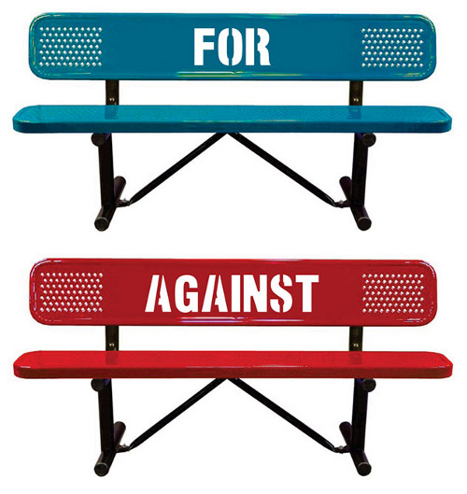
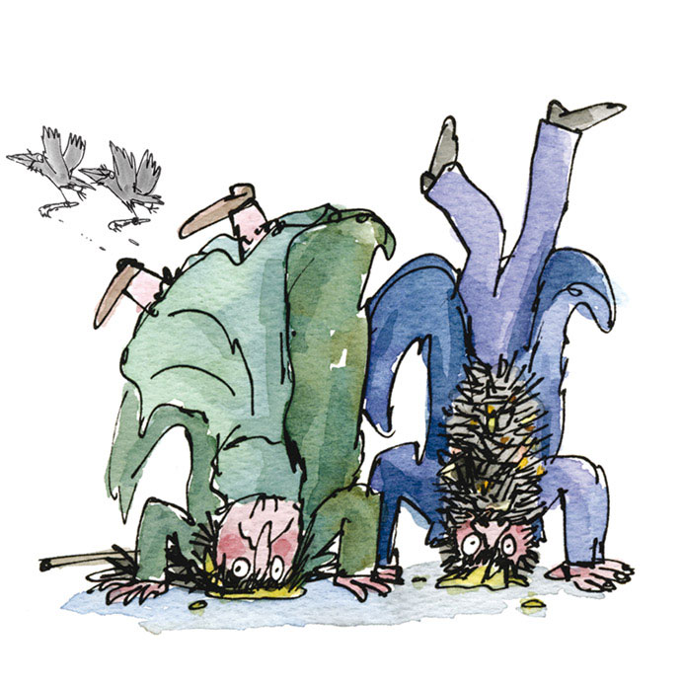
Session 17 Debate whether glue was the right way to go…
Was it humane to glue The Twits to the floor? Was it fair? Do two wrongs make a right? Should they have been imprisoned instead?
Split the class in two. One side should think of reasons why gluing The Twits was the right action to take and the other side needs to think of reasons that gluing them to the ceiling was the wrong cause of action. Then set up the classroom with the opposing sides at different ends and see who wins the debate!
debate two-sided wrong right argument bias
fact opinion

Slide 20
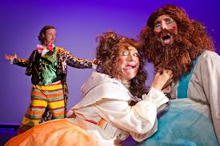
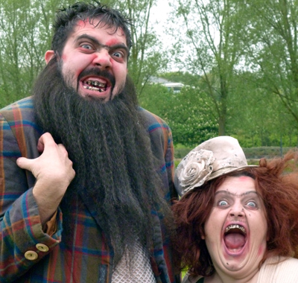
Session 18 Guess the act
In your group, choose a small section from the story. Don’t tell anyone else! Practice acting out this part and make sure everyone in your group is included. You’ll need to think about facial expressions, body language and how you’re using your voice.

Slide 21
Session 19 Investigate language in Chapter 24
Read Chapter 24 and answer the questions. Some of the questions are about language while others are about punctuation and understanding the story…

Slide 22
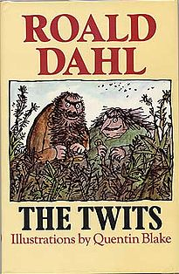
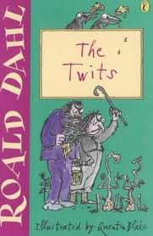
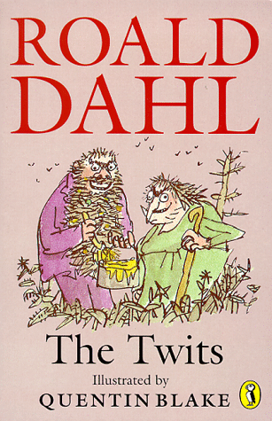
Session 20 Which front cover is most eye-catching and why?
Design your own front cover that you think is even more eye-catching than the examples above. How will you make a cover that people will want to buy?

Slide 23
Session 21 Change the characters
What if there was no Mr. Twit? No Mrs. Twit? No Muggle-Wump family? And no Roly-Poly bird?
Write a list of adjectives to describe each personality and then create new characters with similar personalities to those in The Twits.
Draw your new character
Use adjectives to describe your new character’s looks and personality

Slide 24
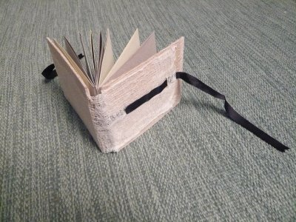
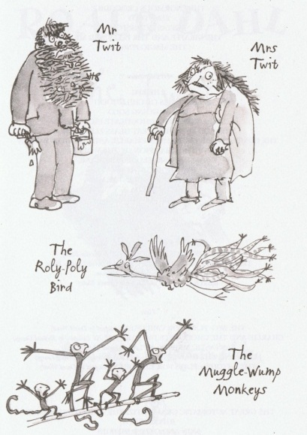
Session 22 Make your own book cover
Use your design from session 20 to create your own book cover. This book will be used to keep all of your project work on The Twits and will be put on display.
author publisher title blurb illustrator reviews
logo slogan price

Slide 25
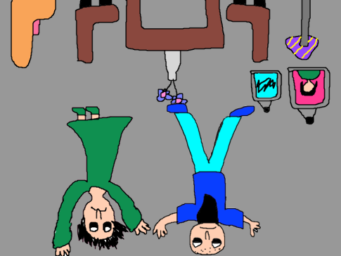
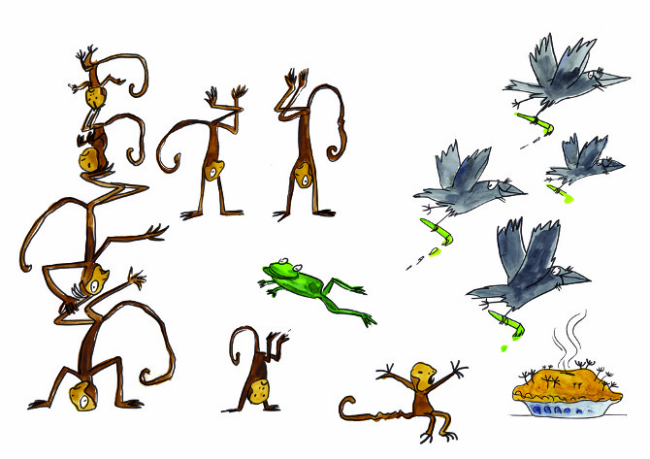
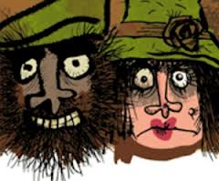
Ideas for further learning…
1 – Author study of R.Dahl
2 – Character profiles
3 – Story Map
4 – Look at different adaptations of The Twits on youtube, discuss preferences
5 – Make a living room in a shoebox identical to the one in the story
6 – Make a menu of nasty recipes
7 – Walking stick tangrams
8 – AN advert for HUGTIGHT glue

